Slide 1


Exploratory Analysis of COVID-19 Mortality Risk Factors in the United States
Track D: Epidemiology of COVID-19
Group 5
Notes:
Points on Slide

Slide 2
Introduction and Objective
The current Covid-19 crisis has created an unprecedented public health and economic emergency
Current understanding of the virus spread and it’s mortality pattern is limited; however, significant amounts of data have been collected and made publicly available
Objective: To find the relationship of the sociodemographic and health service factors with the COVID-19 mortality in the United States.
Study GitHub repository: github.com/AmirAvnit/COVID-19_MIT_DataThon_Team_E5
Notes:
Bullet points on slide

Slide 3
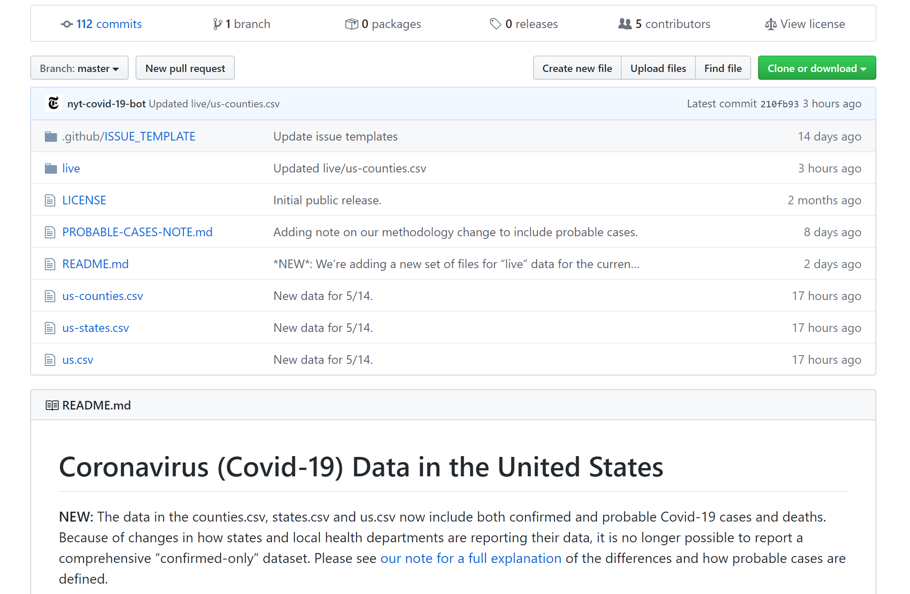
Methodology Overview
We used counties as our observation unit
Data was collected, preprocessed and analyzed via R and python
R packages: pscl and parameters
Python libraries: numpy, pandas, scipy and sklearn
Data was visualized via Tableau, R and python
R packages: ggplot2
Python libraries: matplotlib and seaborn
Notes:
Bullet Points on Slide

Slide 4
Data Collection
Open-source datasets were explored for potential predictors of COVID19 mortality
Housing & population per Area
Availability of health professionals
Hospital Bed and ICU Capacity
Lockdown Length
COVID-19 County Level Data
Socioeconomic, Behavioral & Life Quality rankings
Morbidity, Obesity & Smoking Prevalence
Sources: https://www.usatoday.com/storytelling/coronavirus-reopening-america-map/ https://github.com/nytimes/covid-19-data https://github.com/JieYingWu/COVID-19_US_County-level_Summaries
All datasets and our processed data can be found in the study’s GitHub repository: github.com/AmirAvnit/COVID-19_MIT_DataThon_Team_E5
Notes:
Data Methods:
Cumulative COVID-19 data for case and death
Not Time Series (other than lockdown)
All of our data sources and our processed data can be found in our GitHub

Slide 5
Data Preprocessing
Multiple relevant open-source datasets were examined and obtained
Irrelevant variables and variables with high numbers of missing values were omitted (25% or above NAs)
Cases with missing values for predicted variable (death rates) were omitted
Variables were normalized according to county population size (1 per 1,000 people)
All processed data can be found on the study’s GitHub repository: github.com/AmirAvnit/COVID-19_MIT_DataThon_Team_E5
Notes:
Bullet points on Slide

Slide 6
Feature Selection
A random forest model was trained on the data (n trees = 1,000). Then, 14 Features with Gini importance indices (mean decrease in impurity) > .002 were selected
Features having a Pearson correlation of r=.75 or above with another feature having higher Gini importance index were taken out (4 removed)
The remaining 10 features were included in the analysis:
# ICU beds; % Adult obesity; Quality of life rank; % Excessive drinking; Life expectancy rank; Population density (per mi²); Clinical care rank; % Adult smoking; # Specialists physicians; Physical environment rank
To access the relationship, negative binomial regression was used and adjusted for the population, proportion of physician and number of test done
Notes:
Bullet Points on Slide

Slide 7
Results and Key Findings

Slide 8
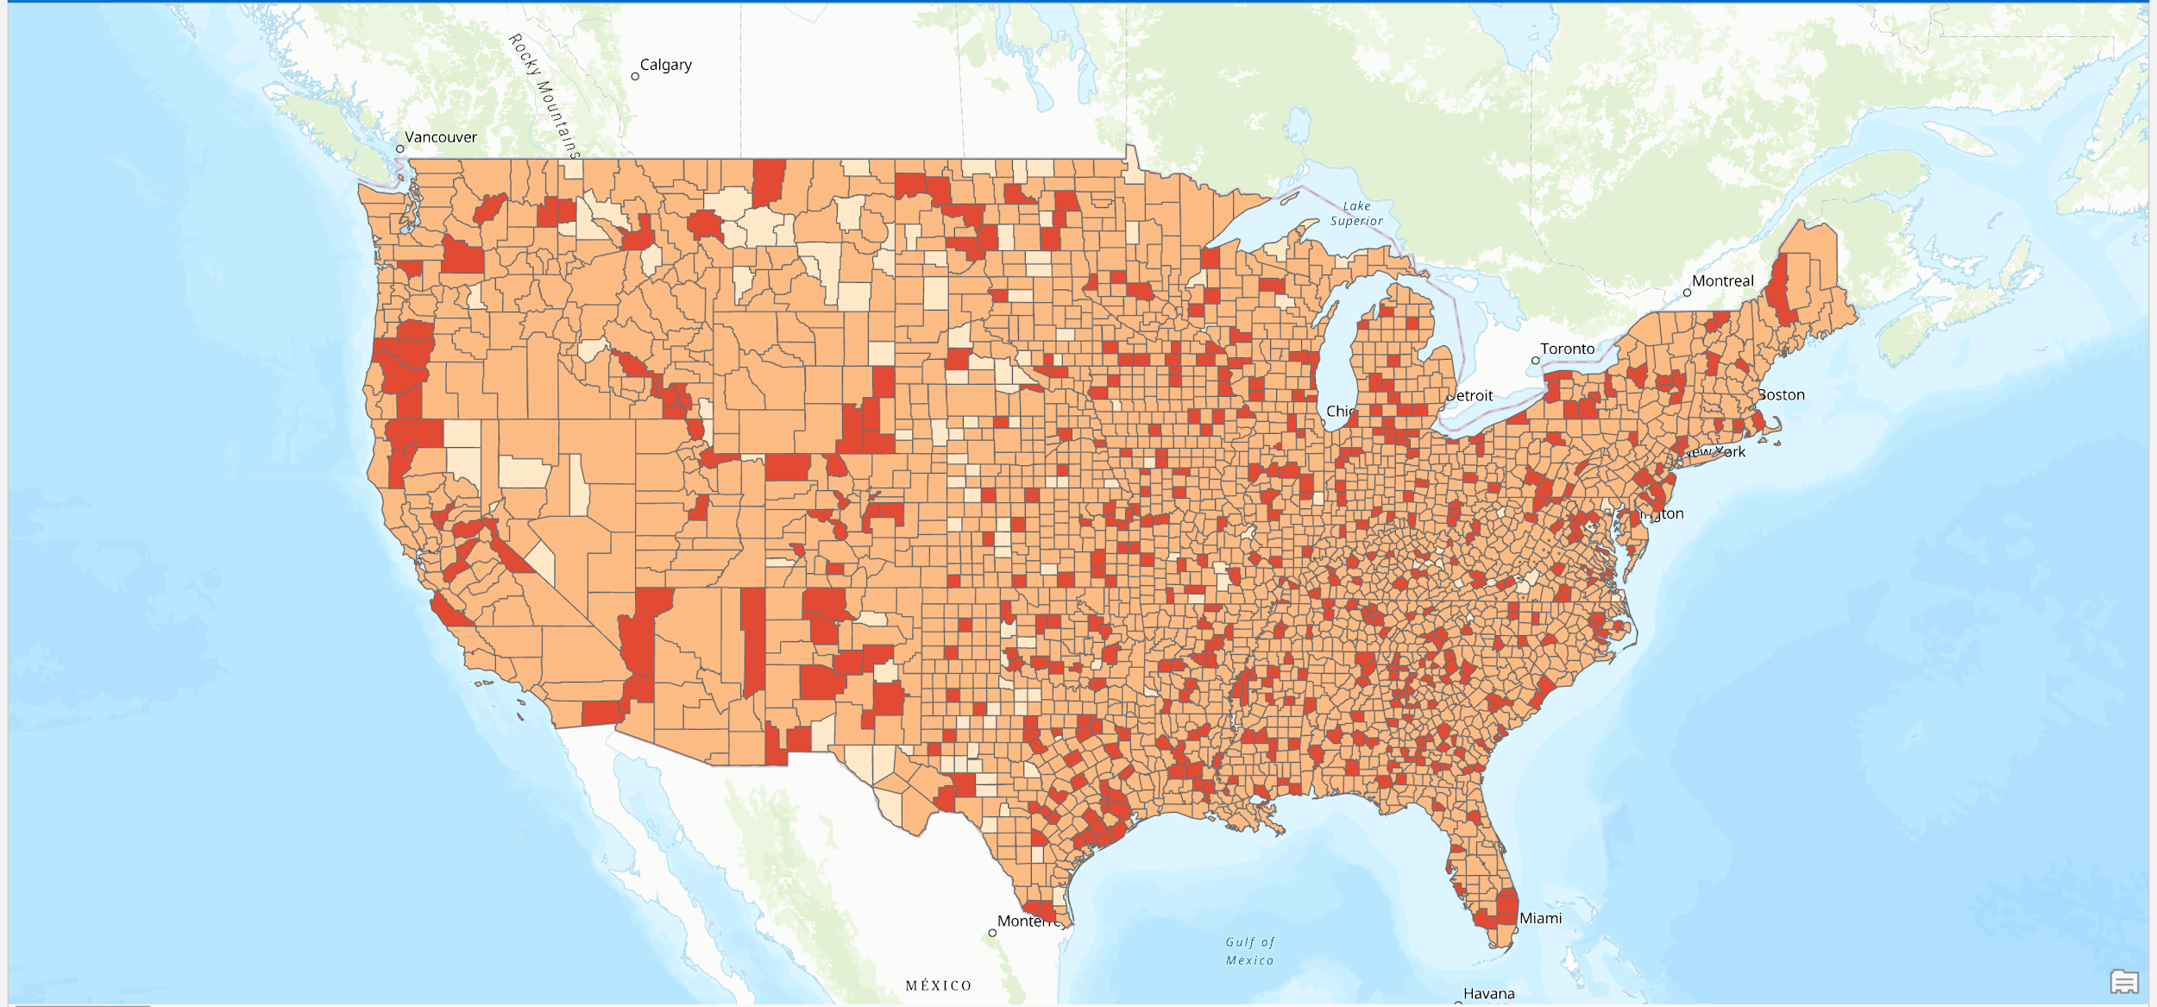
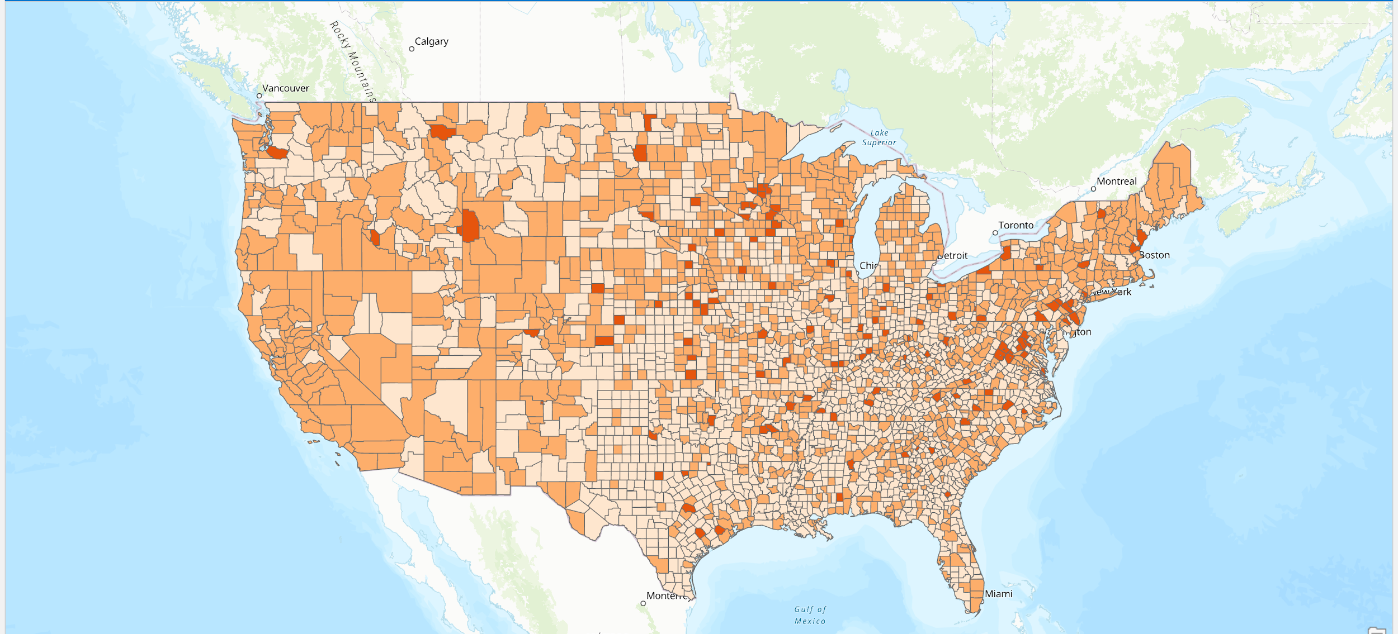
Virus Spread and Healthcare Workers by County
Healthcare workers
COVID-19 cases
Notes:
In this visual you can see the healthcare workers by county and the covid-19 cases by county
The dataset divided it into 3 feature classes (high, medium, and low)
So we did the same thing for the COVID-19 cases, but dividing it equally into 3 feature classes with the same number of cases in each class
There is a lot of overlap between the places where there are a so-called medium amount of health workers and where there are medium amount of cases especially on the west coast

Slide 9
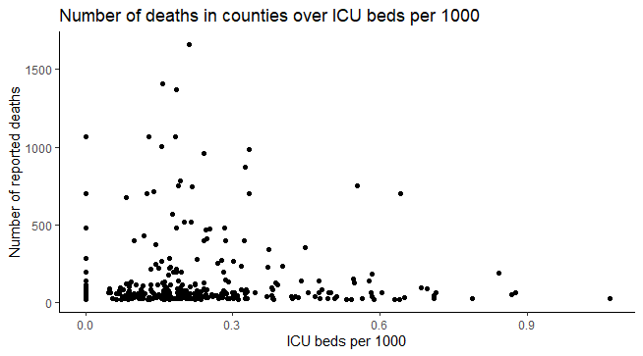
Notes:
At first glance you might not think there is a strong correlation between the ICU Beds and the number of reported deaths but there still is a correlation. But the main issue is that why are most of the counties clustered around the low area down here. The ICU Beds and reported deaths have a correlation but our focus should be on why are these countries starting off with low ICU bed numbers in the first place. So we looked at many factors indluig population density, lockdown times, and number of tests conducted to help adjust for graphs like these which then will give us a better overview of the data

Slide 10
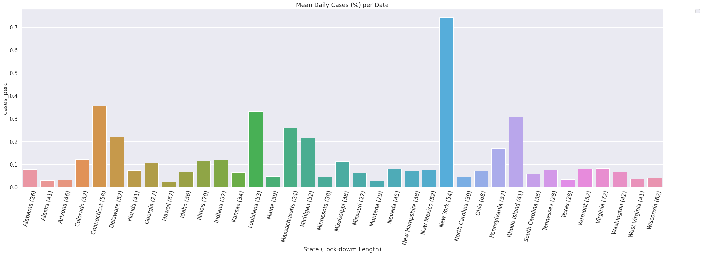
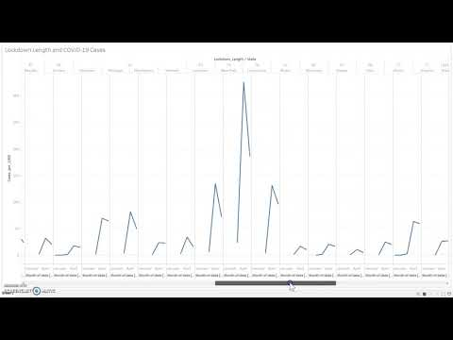
Lockdown and Average Daily Cases Per Day
Mean Daily Cases
COVID-19 Cases (%)
State (Lock-down Length)
Notes:
Here we have the lockdown data for each state and the number of days it spent in lockdown with the mean daily case percentage

Slide 11
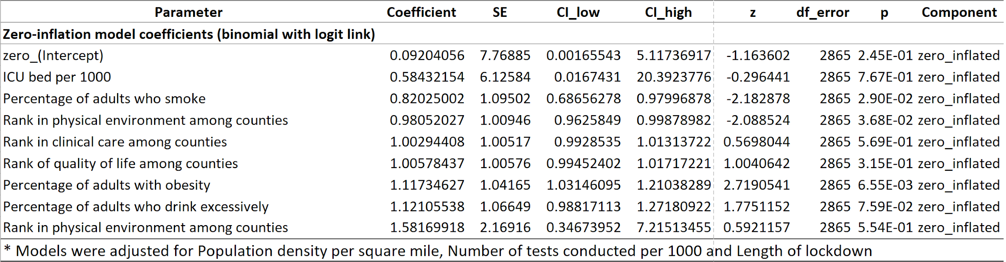
Multiple Regression Analysis
Used to examine the unique contribution of each selected feature to the mortality rate of COVID-19
A zero-inflation model with coefficients was used to account for null variables
Notes:
Bullet Points on Slide

Slide 12
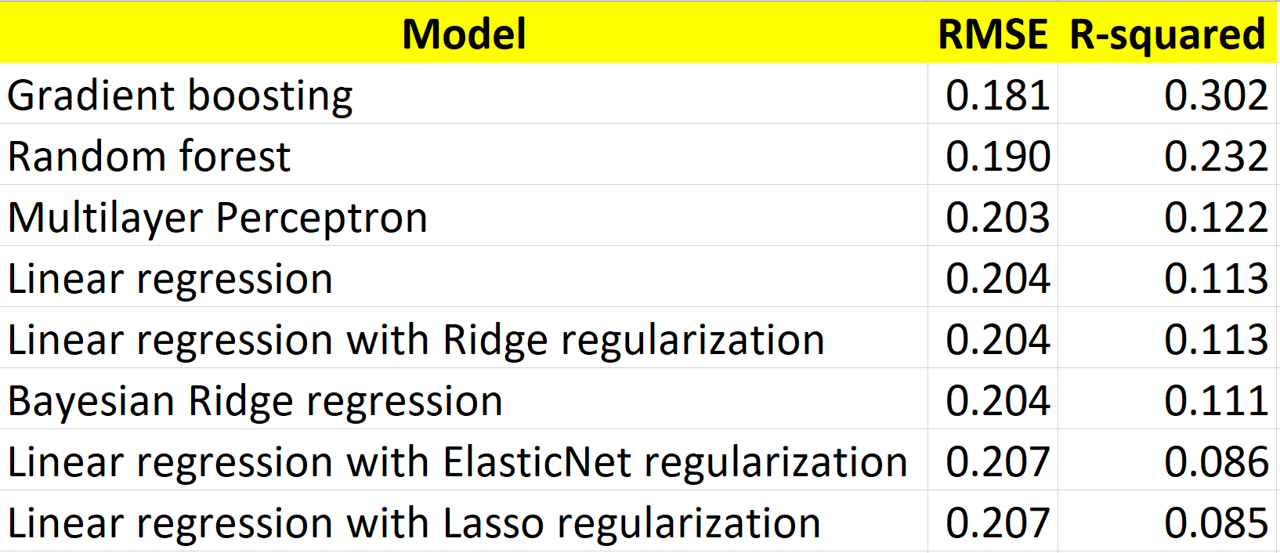
Machine Learning Analyses
Data was randomly split into training and test subsets (75% and 25% of data, respectively), and models were trained and optimized
Best performance was obtained by a Gradient Boosting model, explaining 30.2% of the variance of COVID-19 mortality in the United States
Notes:
Gradient Boosting and Random forest: an ensemble of individual decision trees are trained on different parts of the same training set.
Model prediction is the mean of individual trees’ prediction.
Unlike random forest, In gradient boosting trees are not built independently, but rather are trained to improve shortcomings of previously trained trees; also, trees showing performance have more effect on model prediction.
Linear regression: models the relationship between two variables by fitting a linear equation to observed data, commonly optimized by minimizing the mean square distance between the line and training data points.
Multilayer Perceptron: is the deep neural network model that was created in order to better analyze the relationship between the individual predictive factors and COVID-19’s mortality rate

Slide 13
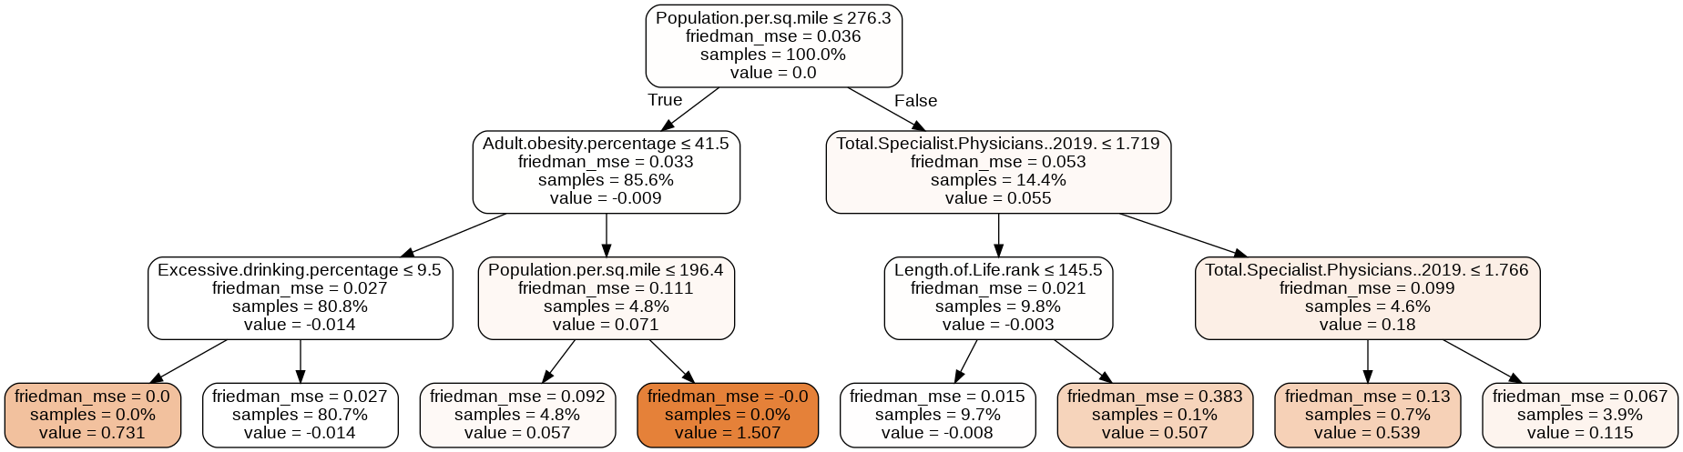
Example of a Gradient Boosting Decision Tree
Notes:
A decision is made at each branch according to a given rule, splitting the data in two ways.

Slide 14
Conclusions and Future Directions
10 factors uniquely related to COVID-19 mortality were obtained
Out of the models tested, Gradient Boosting showed the best performance, being able to explain 30.2% of the variance of the number of death cases in US counties.
Going Forward:
Examine additional factors to explain more of the COVID-19 mortality variance
Examine the specific roles of different factors for different US counties
Obtain risk factors depending on location and individual attributes
The user inputs the county they are living in, their age, some demographic information (smoker, diabetic, etc.) and we output the chance of survival if the individual is infected with COVID-19
Notes:
Add after the third bullet point and before the predictive model: We have found the majority of individual predictors using regression, decision tree ensemble and deep neural network techniques, while adjusting for numerous variables.

